Slide 1
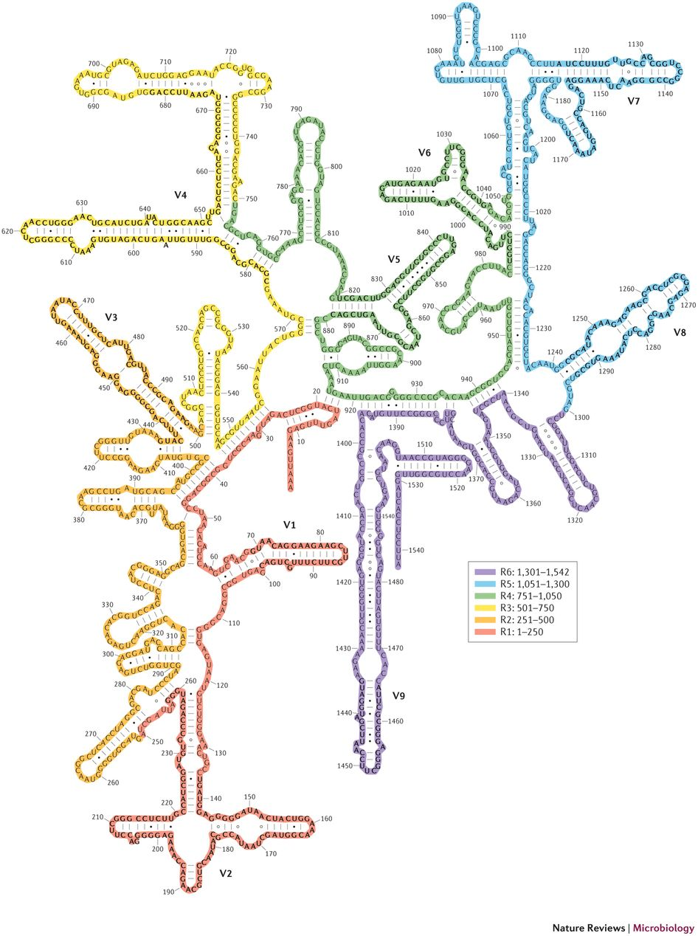
16S rRNA GENE SEQUENCING
encodes the small subunit ribosomal RNA molecules of ribosomes
highly conserved, interspersed with hypervariable regions (V1-V9)
PCR-based amplicon sequencing
Short-read sequencing (150-250bp)
Genus or higher
*Pretty much everything, anyway

Slide 2
TYPICAL WORKFLOW
Sample
DNA isolation
Amplify DNA
Purify DNA
Validate Amplification
Quantify and Normalize DNA pool
Dilute and Denature DNA pool
Sequence

Slide 3
BIOINFORMATICS

Slide 4
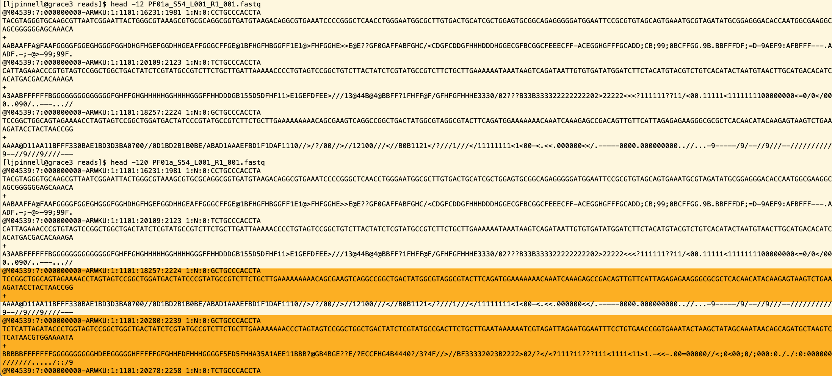

Slide 5
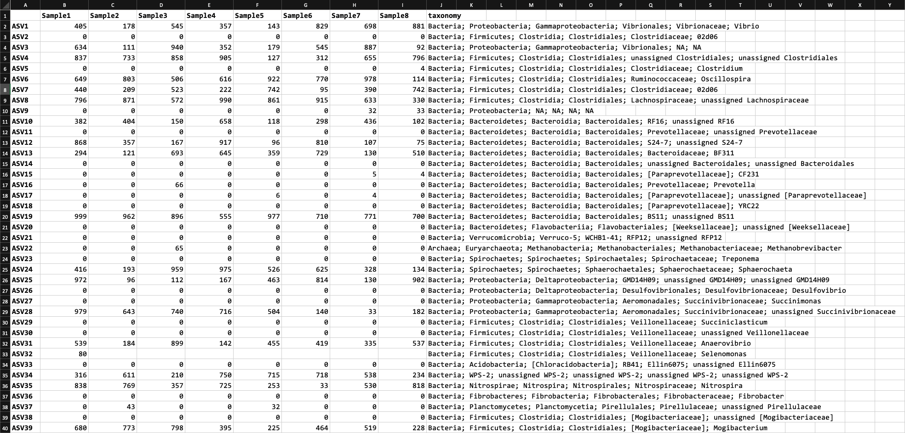

Slide 6
